Slide 1

Chapter 3
Transport Layer
Computer Networking: A Top Down Approach
7th edition
Jim Kurose, Keith Ross
Pearson/Addison Wesley
April 2016
2-<number>

Slide 2
Chapter 3: Transport Layer
our goals:
understand principles behind transport layer services:
  multiplexing, demultiplexing
  reliable data transfer
  flow control
  congestion control
learn about Internet transport layer protocols:
  UDP: connectionless transport
  TCP: connection-oriented reliable transport
  TCP congestion control
Transport Layer
3-<number>
Notes:
User datagram
Transport control protocol

Slide 3
Transport vs. network layer
network layer: logical communication between hosts
transport layer: logical communication between processes
  relies on, enhances, network layer services
household analogy:
12 kids in Ann’s house sending letters to 12 kids in Bill’s house:
hosts = houses
processes = kids
app messages = letters in envelopes
transport protocol = Ann and Bill who demux to in-house siblings
network-layer protocol = postal service
Transport Layer
3-<number>

Slide 4

















Internet transport-layer protocols
reliable, in-order delivery (TCP)
  congestion control
  flow control
  connection setup
unreliable, unordered delivery: UDP
  no-frills extension of “best-effort” IP
services not available:
  delay guarantees
  bandwidth guarantees
application
transport
network
data link
physical
network
data link
physical
network
data link
physical
network
data link
physical
logical end-end transport
network
data link
physical
network
data link
physical
network
data link
physical
network
data link
physical
application
transport
network
data link
physical
Transport Layer
3-<number>

Slide 5

Multiplexing/demultiplexing
multiplexing at sender:
handle data from multiple
sockets, add transport header (later used for demultiplexing)
demultiplexing at receiver:
use header info to deliver
received segments to correct
socket
application
application
P1
P2
application
socket
P3
transport
P4
process
transport
network
transport
network
link
network
link
physical
link
physical
physical
Transport Layer
3-<number>
Notes:
let’s consider how a receiving host directs an incoming transport-layer segment
to the appropriate socket. Each transport-layer segment has a set of fields in the
segment for this purpose. At the receiving end, the transport layer examines these
fields to identify the receiving socket and then directs the segment to that socket. This
job of delivering the data in a transport-layer segment to the correct socket is called
demultiplexing. The job of gathering data chunks at the source host from different
sockets, encapsulating each data chunk with header information (that will later be
used in demultiplexing) to create segments, and passing the segments to the network
layer is called multiplexing

Slide 6
How demultiplexing works
host receives IP datagrams
  each datagram has source IP address, destination IP address
  each datagram carries one transport-layer segment
  each segment has source, destination port number
host uses IP addresses & port numbers to direct segment to appropriate socket
32 bits
source port #
dest port #
other header fields
application
data
(payload)
TCP/UDP segment format
Transport Layer
3-<number>
Notes:
Each port number is a 16-bit number, ranging from 0 to
65535. The port numbers ranging from 0 to 1023 are called well-known port numbers
and are restricted, which means that they are reserved for use by well-known
application protocols such as HTTP (which uses port number 80) and FTP (which
uses port number 21). The list of well-known port numbers is given in RFC 1700
and is updated at http://www.iana.org [RFC 3232].

Slide 7
Connectionless demultiplexing
recall: when creating datagram to send into UDP socket, must specify (UDP socket is two tuple)
  destination IP address
  destination port #
recall: created socket has host-local port #:
DatagramSocket mySocket1 = new DatagramSocket(12534);
when host receives UDP segment:
  checks destination port # in segment
  directs UDP segment to socket with that port #
IP datagrams with same dest. port #, but different source IP addresses and/or source port numbers will be directed to same socket at dest
Transport Layer
3-<number>

Slide 8
Connection-oriented demux
TCP socket identified by 4-tuple:
  source IP address
  source port number
  dest IP address
  dest port number
demux: receiver uses all four values to direct segment to appropriate socket
server host may support many simultaneous TCP sockets:
  each socket identified by its own 4-tuple
web servers have different sockets for each connecting client
  non-persistent HTTP will have different socket for each request
Transport Layer
3-<number>

Slide 9
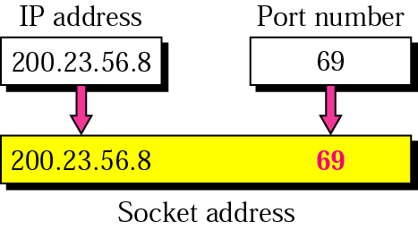
Figure 22.5 Socket address
Notes:
16-bit number =>port addresses=> 2^16

Slide 10
UDP: User Datagram Protocol [RFC 768]
“no frills,” “bare bones” Internet transport protocol
“best effort” service, UDP segments may be:
  lost
  delivered out-of-order to app
connectionless:
  no handshaking between UDP sender, receiver
  each UDP segment handled independently of others
UDP use:
  streaming multimedia apps (loss tolerant, rate sensitive)
  DNS
  SNMP
reliable transfer over UDP:
  add reliability at application layer
  application-specific error recovery!
Transport Layer
3-<number>

Slide 11
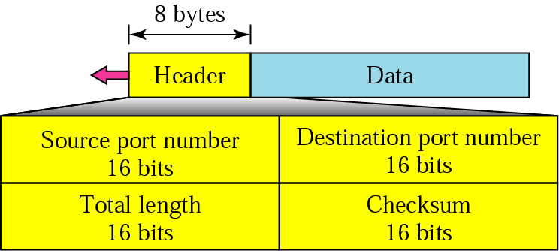
Figure 22.10 UDP segment format
Notes:
Source Port : Source Port is 2 Byte long field used to identify port number of source.
Destination Port : It is 2 Byte long field, used to identify the port of destined packet.
Length : Length is the length of UDP including header and the data. It is 16-bits field.
Checksum : Checksum is 2 Bytes long field. It is the 16-bit one’s complement of the one’s complement sum of the UDP header, pseudo header of information from the IP header and the data, padded with zero octets at the end (if necessary) to make a multiple of two octets.
Unlike TCP, Checksum calculation is not mandatory in UDP. No Error control or flow control is provided by UDP. Hence UDP depends on IP and ICMP for error reporting.

Slide 12
UDP: segment header
length, in bytes of UDP segment, including header
32 bits
source port #
dest port #
Total length
checksum
why is there a UDP?
no connection establishment (which can add delay)
simple: no connection state at sender, receiver
small header size
no congestion control: UDP can blast away as fast as desired
application
data
(payload)
UDP segment format
Transport Layer
3-<number>

Slide 13
UDP checksum
Goal: detect “errors” (e.g., flipped bits) in transmitted segment
sender:
treat segment contents, including header fields, as sequence of 16-bit integers
checksum: addition (one’s complement sum) of segment contents
sender puts checksum value into UDP checksum field
receiver:
compute checksum of received segment
check if computed checksum equals checksum field value:
  NO - error detected
  YES - no error detected. But maybe errors nonetheless? More later ….
Transport Layer
3-<number>

Slide 14
Internet checksum: example
example: add two 16-bit integers
1 1 1 1 0 0 1 1 0 0 1 1 0 0 1 1 0
1 1 1 0 1 0 1 0 1 0 1 0 1 0 1 0 1
1 1 0 1 1 1 0 1 1 1 0 1 1 1 0 1 1
1 1 0 1 1 1 0 1 1 1 0 1 1 1 1 0 0
1 0 1 0 0 0 1 0 0 0 1 0 0 0 0 1 1
wraparound
sum
checksum
Note: when adding numbers, a carryout from the most significant bit needs to be added to the result
* Check out the online interactive exercises for more examples: http://gaia.cs.umass.edu/kurose_ross/interactive/
Transport Layer
3-<number>
Notes:
Kurose and Ross forgot to say anything about wrapping the carry and adding it to low order bit
Note that this last addition had overflow, which was wrapped around. The 1s complement
is obtained by converting all the 0s to 1s and converting all the 1s to 0s.
Thus the 1s complement of the sum 0100101011000010 is 1011010100111101,
which becomes the checksum. At the receiver, all four 16-bit words are added,
including the checksum. If no errors are introduced into the packet, then clearly the
sum at the receiver will be 1111111111111111. If one of the bits is a 0, then we know
that errors have been introduced into the packet.

Slide 15

rdt3.0 in action
sender
receiver
sender
receiver
send pkt0
pkt0
send pkt0
pkt0
rcv pkt0
rcv pkt0
ack0
send ack0
ack0
send ack0
rcv ack0
rcv ack0
send pkt1
pkt1
send pkt1
pkt1
rcv pkt1
X
ack1
send ack1
loss
rcv ack1
send pkt0
pkt0
rcv pkt0
timeout
resend pkt1
ack0
send ack0
pkt1
rcv pkt1
ack1
send ack1
rcv ack1
send pkt0
pkt0
(a) no loss
rcv pkt0
ack0
send ack0
(b) packet loss
Transport Layer
3-<number>
Notes:
Reliable data transfer

Slide 16
rdt3.0 in action
sender
receiver
sender
receiver
send pkt0
pkt0
send pkt0
pkt0
rcv pkt0
rcv pkt0
ack0
send ack0
send ack0
rcv ack0
ack0
send pkt1
pkt1
rcv ack0
rcv pkt1
send pkt1
pkt1
send ack1
rcv pkt1
ack1
send ack1
ack1
X
loss
timeout
resend pkt1
pkt1
rcv pkt1
timeout
resend pkt1
rcv ack1
pkt1
rcv pkt1
pkt0
(detect duplicate)
send pkt0
send ack1
ack1
(detect duplicate)
ack1
rcv pkt0
rcv ack1
send ack1
rcv ack1
ack0
send ack0
pkt0
send pkt0
pkt0
send pkt0
rcv pkt0
rcv pkt0
ack0
(detect duplicate)
ack0
send ack0
send ack0
(c) ACK loss
(d) premature timeout/ delayed ACK
Transport Layer
3-<number>

Slide 17
A problem with previous scenario is - rdt3.0 is a stop and wait protocol.
Rather than operate in a stop-and-wait manner, the sender is allowed to send multiple packets without waiting for acknowledgments.
If the sender is allowed to transmit three packets before having to wait for acknowledgments, the utilization of the sender is essentially tripled. Since the many in-transit sender-to-receiver packets can be visualized as filling a pipeline, this technique is known as pipelining
Transport Layer
3-<number>

Slide 18
Pipelined protocols: overview
Go-back-N:
sender can have up to N unacked packets in pipeline
receiver only sends cumulative ack
  doesn’t ack packet if there’s a gap
sender has timer for oldest unacked packet
  when timer expires, retransmit all unacked packets
Selective Repeat:
sender can have up to N unack’ed packets in pipeline
rcvr sends individual ack for each packet
sender maintains timer for each unacked packet
  when timer expires, retransmit only that unacked packet
Transport Layer
3-<number>
Notes:
The range of sequence numbers must be increased, since each in-transit packet
(not counting retransmissions) must have a unique sequence number and there
may be multiple, in-transit, unacknowledged packets.
• The sender and receiver sides of the protocols may have to buffer more than one
packet. Minimally, the sender will have to buffer packets that have been transmitted
but not yet acknowledged. Buffering of correctly received packets may
also be needed at the receiver, as discussed below.
• The range of sequence numbers needed and the buffering requirements will
depend on the manner in which a data transfer protocol responds to lost, corrupted,
and overly delayed packets. Two basic approaches toward pipelined error
recovery can be identified: Go-Back-N and selective repeat.

Slide 19

Go-Back-N: sender
k-bit seq # in pkt header
“window” of up to N, consecutive unack’ed pkts allowed
ACK(n): ACKs all pkts up to, including seq # n - “cumulative ACK”
  may receive duplicate ACKs (see receiver)
timer for oldest in-flight pkt
timeout(n): retransmit packet n and all higher seq # pkts in window
Transport Layer
3-<number>

Slide 20
GBN in action
sender window (N=4)
sender
receiver
0 1 2 3 4 5 6 7 8
send pkt0
send pkt1
send pkt2
send pkt3
(wait)
0 1 2 3 4 5 6 7 8
receive pkt0, send ack0
receive pkt1, send ack1
receive pkt3, discard,
(re)send ack1
0 1 2 3 4 5 6 7 8
X
0 1 2 3 4 5 6 7 8
loss
0 1 2 3 4 5 6 7 8
rcv ack0, send pkt4
rcv ack1, send pkt5
0 1 2 3 4 5 6 7 8
receive pkt4, discard,
(re)send ack1
ignore duplicate ACK
receive pkt5, discard,
(re)send ack1
pkt 2 timeout
0 1 2 3 4 5 6 7 8
send pkt2
send pkt3
send pkt4
send pkt5
0 1 2 3 4 5 6 7 8
0 1 2 3 4 5 6 7 8
rcv pkt2, deliver, send ack2
rcv pkt3, deliver, send ack3
rcv pkt4, deliver, send ack4
rcv pkt5, deliver, send ack5
0 1 2 3 4 5 6 7 8
Transport Layer
3-<number>
Notes:
only piece of information the receiver need maintain is the sequence number of the next in-order packet.
The advantage of this approach is the simplicity of receiver buffering—the receiver need not buffer any out-of-order packets.
Window size to maintain flow control

Slide 21
Selective repeat
receiver individually acknowledges all correctly received pkts
  buffers pkts, as needed, for eventual in-order delivery to upper layer
sender only resends pkts for which ACK not received
  sender timer for each unACKed pkt
sender window
  N consecutive seq #’s
  limits seq #s of sent, unACKed pkts
Transport Layer
3-<number>

Slide 22

Selective repeat: sender, receiver windows
Transport Layer
3-<number>

Slide 23
Selective repeat
sender
receiver
data from above:
if next available seq # in window, send pkt
timeout(n):
resend pkt n, restart timer
ACK(n) in [sendbase,sendbase+N]:
mark pkt n as received
if n smallest unACKed pkt, advance window base to next unACKed seq #
pkt n in [rcvbase, rcvbase+N-1]
send ACK(n)
out-of-order: buffer
in-order: deliver (also deliver buffered, in-order pkts), advance window to next not-yet-received pkt
pkt n in [rcvbase-N,rcvbase-1]
ACK(n)
otherwise:
ignore
Transport Layer
3-<number>

Slide 24
Selective repeat in action
sender window (N=4)
sender
receiver
0 1 2 3 4 5 6 7 8
send pkt0
send pkt1
send pkt2
send pkt3
(wait)
0 1 2 3 4 5 6 7 8
receive pkt0, send ack0
receive pkt1, send ack1
receive pkt3, buffer,
send ack3
0 1 2 3 4 5 6 7 8
X
0 1 2 3 4 5 6 7 8
loss
0 1 2 3 4 5 6 7 8
rcv ack0, send pkt4
rcv ack1, send pkt5
0 1 2 3 4 5 6 7 8
receive pkt4, buffer,
send ack4
record ack3 arrived
receive pkt5, buffer,
send ack5
pkt 2 timeout
0 1 2 3 4 5 6 7 8
send pkt2
0 1 2 3 4 5 6 7 8
record ack4 arrived
0 1 2 3 4 5 6 7 8
rcv pkt2; deliver pkt2,
pkt3, pkt4, pkt5; send ack2
record ack5 arrived
0 1 2 3 4 5 6 7 8
Q: what happens when ack2 arrives?
Transport Layer
3-<number>

Slide 25

Selective repeat: dilemma
sender window
(after receipt)
receiver window
(after receipt)
0 1 2 3 0 1 2
pkt0
0 1 2 3 0 1 2
pkt1
0 1 2 3 0 1 2
example:
seq #’s: 0, 1, 2, 3
window size=3
0 1 2 3 0 1 2
pkt2
0 1 2 3 0 1 2
0 1 2 3 0 1 2
0 1 2 3 0 1 2
pkt3
X
0 1 2 3 0 1 2
pkt0
will accept packet
with seq number 0
receiver sees no difference in two scenarios!
duplicate data accepted as new in (b)
Q: what relationship between seq # size and window size to avoid problem in (b)?
(a) no problem
receiver can’t see sender side.
receiver behavior identical in both cases!
something’s (very) wrong!
0 1 2 3 0 1 2
pkt0
0 1 2 3 0 1 2
pkt1
0 1 2 3 0 1 2
0 1 2 3 0 1 2
pkt2
0 1 2 3 0 1 2
X
0 1 2 3 0 1 2
X
timeout
retransmit pkt0
X
0 1 2 3 0 1 2
pkt0
will accept packet
with seq number 0
(b) oops!
Transport Layer
3-<number>

Slide 26
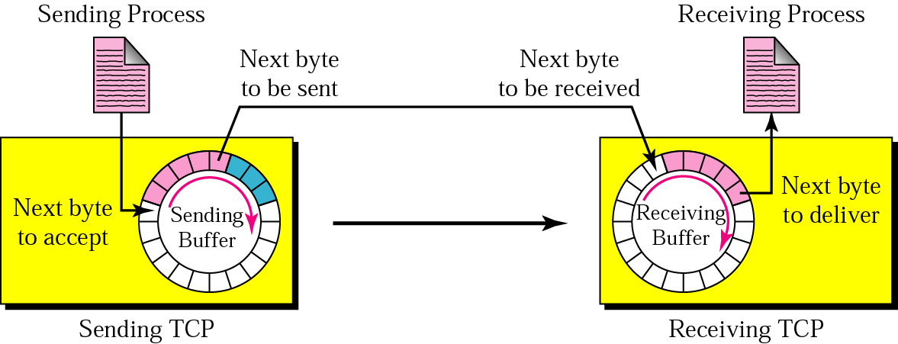
Figure 22.12 Sending and receiving buffers

Slide 27
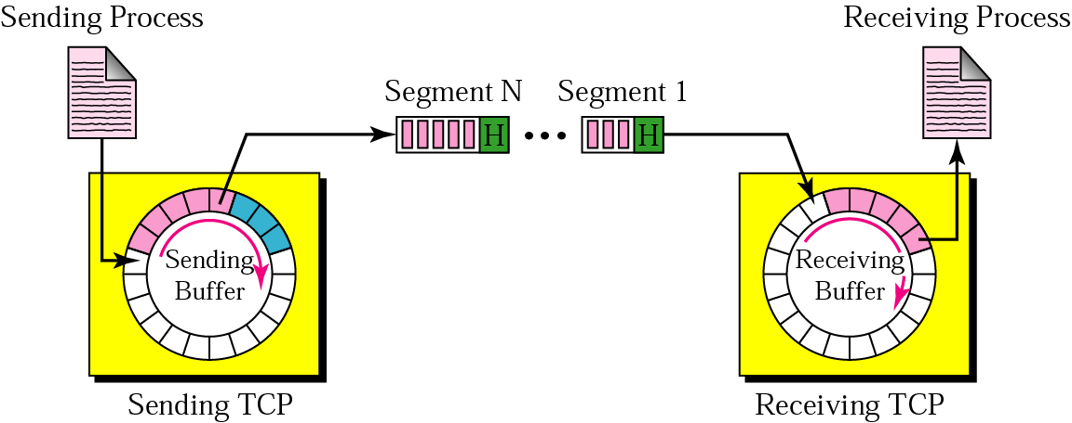
Figure 22.13 TCP segments

Slide 28
Reading Task:
Transmission modes:
https://www.geeksforgeeks.org/transmission-modes-computer-networks/
Point-to-point&multi point connection
https://www.geeksforgeeks.org/differences-between-point-to-point-and-multi-point-communication/
Transport Layer
3-<number>

Slide 29
TCP: Overview RFCs: 793,1122,1323, 2018, 2581
point-to-point: (connection)
  one sender, one receiver (multicasting is not possible)
reliable, in-order byte steam:
  no “message boundaries”
pipelined:
  TCP congestion and flow control set window size
full duplex data:
  bi-directional data flow in same connection
  MSS: maximum segment size
connection-oriented:
  handshaking (exchange of control msgs) inits sender, receiver state before data exchange
flow controlled:
  sender will not overwhelm receiver
Transport Layer
3-<number>

Slide 30
TCP segment structure
32 bits
URG: urgent data
(generally not used)
counting
by bytes
of data
(not segments!)
source port #
dest port #
sequence number
ACK: ACK #
valid
acknowledgement number
head
len
not
used
U
receive window
A
PSH: push data now
(generally not used)
P
R
S
F
# bytes
rcvr willing
to accept
checksum
Urg data pointer
RST, SYN, FIN:
connection estab
(setup, teardown
commands)
options (variable length)
application
data
(variable length)
Internet
checksum
(as in UDP)
Transport Layer
3-<number>
Notes:
The primary purpose of this field is to inform the recipient where the data portion of the TCP segment starts. Due to space constraints, the value of this field uses 32-bit multiples. Thus, 20 bytes is the same as 160 bits, which would be shown here as 5 (5 × 32 bits = 160 bits = 20 bytes). Since each of the header’s mandatory fields are fixed in size, the smallest this value can be is 5.
If all of the bits in this field were “on,” the maximum value would be 15. Thus, a TCP header can be no larger than 60 bytes (15 × 32 bits = 480 bits = 60 bytes).

Slide 31
TCP seq. numbers, ACKs
outgoing segment from sender
sequence numbers:
  byte stream “number” of first byte in segment’s data
acknowledgements:
  seq # of next byte expected from other side
  cumulative ACK
Q: how receiver handles out-of-order segments
  A: TCP spec doesn’t say, - up to implementor
  (Read form Book: Chpater 3 ,page 235…)
source port #
dest port #
sequence number
acknowledgement number
rwnd
checksum
urg pointer
window size
N
  sender sequence number space
sent
ACKed
sent, not-yet ACKed
(“in-flight”)
usable
but not
yet sent
not
usable
incoming segment to sender
source port #
dest port #
sequence number
acknowledgement number
A
rwnd
checksum
urg pointer
Transport Layer
3-<number>

Slide 32
TCP seq. numbers, ACKs
Host A
Host B
User
types
‘C’
Seq=42, ACK=79, data = ‘C’
host ACKs
receipt of
‘C’, echoes
back ‘C’
Seq=79, ACK=43, data = ‘C’
host ACKs
receipt
of echoed
‘C’
Seq=43, ACK=80
simple telnet scenario
Transport Layer
3-<number>

Slide 33
Chapter 3 outline
3.1 transport-layer services
3.2 multiplexing and demultiplexing
3.3 connectionless transport: UDP
3.4 principles of reliable data transfer
3.5 connection-oriented transport: TCP
  segment structure
  reliable data transfer
  flow control
  connection management
3.6 principles of congestion control
3.7 TCP congestion control
Transport Layer
3-<number>

Slide 34
TCP reliable data transfer
TCP creates rdt service on top of IP’s unreliable service
  pipelined segments
  cumulative acks
  single retransmission timer
retransmissions triggered by:
  timeout events
  duplicate acks
let’s initially consider simplified TCP sender:
  ignore duplicate acks
  ignore flow control, congestion control
Transport Layer
3-<number>

Slide 35
TCP sender events:
data rcvd from app:
create segment with seq #
seq # is byte-stream number of first data byte in segment
start timer if not already running
  think of timer as for oldest unacked segment
timeout:
retransmit segment that caused timeout
restart timer
ack rcvd:
if ack acknowledges previously unacked segments
  update what is known to be ACKed
  start timer if there are still unacked segments
Transport Layer
3-<number>

Slide 36
TCP: retransmission scenarios
Host A
Host B
Host A
Host B
Seq=92, 8 bytes of data
Seq=92, 8 bytes of data
timeout
timeout
Seq=100, 20 bytes of data
ACK=100
X
ACK=100
ACK=120
Seq=92, 8 bytes of data
Seq=92, 8
bytes of data
ACK=100
ACK=120
lost ACK scenario
premature timeout
Transport Layer
3-<number>

Slide 37
TCP: retransmission scenarios
Host A
Host B
Seq=92, 8 bytes of data
Seq=100, 20 bytes of data
timeout
ACK=100
X
ACK=120
Seq=120, 15 bytes of data
cumulative ACK
Transport Layer
3-<number>

Slide 38
TCP ACK generation [RFC 1122, RFC 2581]
event at receiver
arrival of in-order segment with
expected seq #. All data up to
expected seq # already ACKed
arrival of in-order segment with
expected seq #. One other
segment has ACK pending
arrival of out-of-order segment
higher-than-expect seq. # .
Gap detected
arrival of segment that
partially or completely fills gap
TCP receiver action
delayed ACK. Wait up to 500ms
for next segment. If no next segment,
send ACK
immediately send single cumulative
ACK, ACKing both in-order segments
immediately send duplicate ACK,
indicating seq. # of next expected byte
immediate send ACK, provided that
segment starts at lower end of gap
Transport Layer
3-<number>

Slide 39
TCP fast retransmit
time-out period often relatively long:
  long delay before resending lost packet
detect lost segments via duplicate ACKs.
  sender often sends many segments back-to-back
  if segment is lost, there will likely be many duplicate ACKs.
TCP fast retransmit
if sender receives 3 ACKs for same data
(“triple duplicate ACKs”), resend unacked segment with smallest seq #
  likely that unacked segment lost, so don’t wait for timeout
(“triple duplicate ACKs”),
Transport Layer
3-<number>

Slide 40
TCP fast retransmit
Host A
Host B
Seq=92, 8 bytes of data
Seq=100, 20 bytes of data
X
ACK=100
timeout
ACK=100
ACK=100
ACK=100
Seq=100, 20 bytes of data
fast retransmit after sender
receipt of triple duplicate ACK
Transport Layer
3-<number>

Slide 41
Chapter 3 outline
3.1 transport-layer services
3.2 multiplexing and demultiplexing
3.3 connectionless transport: UDP
3.4 principles of reliable data transfer
3.5 connection-oriented transport: TCP
  segment structure
  reliable data transfer
  flow control
  connection management
3.6 principles of congestion control
3.7 TCP congestion control
Transport Layer
3-<number>

Slide 42
TCP flow control
application
process
application may
remove data from
TCP socket buffers ….
application
TCP socket
receiver buffers
OS
… slower than TCP
receiver is delivering
(sender is sending)
TCP
code
flow control
IP
code
receiver controls sender, so sender won’t overflow receiver’s buffer by transmitting too much, too fast
from sender
receiver protocol stack
Transport Layer
3-<number>

Slide 43
TCP flow control
receiver “advertises” free buffer space by including rwnd value in TCP header of receiver-to-sender segments
  RcvBuffer size set via socket options (typical default is 4096 bytes)
  many operating systems autoadjust RcvBuffer
sender limits amount of unacked (“in-flight”) data to receiver’s rwnd value
guarantees receive buffer will not overflow
to application process
RcvBuffer
buffered data
rwnd
free buffer space
TCP segment payloads
receiver-side buffering
Transport Layer
3-<number>

Slide 44
Principles of congestion control
congestion:
informally: “too many sources sending too much data too fast for network to handle”
different from flow control!
manifestations:
  lost packets (buffer overflow at routers)
  long delays (queueing in router buffers)
a top-10 problem!
Transport Layer
3-<number>

Slide 45

Causes/costs of congestion: scenario 1
original data: λ_{in}
throughput: λ_{out}
two senders, two receivers
one router, infinite buffers
output link capacity: R
no retransmission
Host A
unlimited shared output link buffers
Host B
R/2
λ_{out}
delay
λ_{in}
R/2
λ_{in}
R/2
maximum per-connection throughput: R/2
large delays as arrival rate, λ_{in}, approaches capacity
Transport Layer
3-<number>

Slide 46
Causes/costs of congestion: scenario 2
one router, finite buffers
sender retransmission of timed-out packet
  application-layer input = application-layer output: λ_{in} = λ_{out}
  transport-layer input includes retransmissions : λ_{in} λ_{in}
‘
λ_{in} : original data
λ'_{in}: original data, plus retransmitted data
λ_{out}
Host A
finite shared output link buffers
Host B
Transport Layer
3-<number>

Slide 47
Causes/costs of congestion: scenario 2
R/2
idealization: perfect knowledge
sender sends only when router buffers available
λ_{out}
λ_{in}
R/2
λ_{in} : original data
copy
λ'_{in}: original data, plus retransmitted data
λ_{out}
A
free buffer space!
finite shared output link buffers
Host B
Transport Layer
3-<number>

Slide 48

Causes/costs of congestion: scenario 2
Idealization: known loss packets can be lost, dropped at router due to full buffers
sender only resends if packet known to be lost
λ_{in} : original data
copy
λ'_{in}: original data, plus retransmitted data
λ_{out}
A
no buffer space!
Host B
Transport Layer
3-<number>

Slide 49
Causes/costs of congestion: scenario 2
Idealization: known loss packets can be lost, dropped at router due to full buffers
sender only resends if packet known to be lost
R/2
when sending at R/2, some packets are retransmissions but asymptotic goodput is still R/2 (why?)
λ_{out}
λ_{in}
R/2
λ_{in} : original data
λ'_{in}: original data, plus retransmitted data
λ_{out}
A
free buffer space!
Host B
Transport Layer
3-<number>

Slide 50


Causes/costs of congestion: scenario 2
Realistic: duplicates
packets can be lost, dropped at router due to full buffers
sender times out prematurely, sending two copies, both of which are delivered
R/2
when sending at R/2, some packets are retransmissions including duplicated that are delivered!
λ_{out}
λ_{in}
R/2
λ_{in}
copy
λ'_{in}
λ_{out}
timeout
A
free buffer space!
Host B
Transport Layer
3-<number>

Slide 51
Causes/costs of congestion: scenario 2
Realistic: duplicates
packets can be lost, dropped at router due to full buffers
sender times out prematurely, sending two copies, both of which are delivered
R/2
when sending at R/2, some packets are retransmissions including duplicated that are delivered!
λ_{out}
λ_{in}
R/2
“costs” of congestion:
more work (retrans) for given “goodput”
unneeded retransmissions: link carries multiple copies of pkt
  decreasing goodput
Transport Layer
3-<number>

Slide 52
End-to-end congestion control.
Network-assisted congestion control.
Transport Layer
3-<number>

